Slide 1
Spinal Case Study
Shankaran Rajmanickam
Consultant Physiotherapist, Bolton NHS FT
&
Senior Lecturer / FCP Module Lead
UCLan

Slide 2
19 year old male
7/12 H/O LBP, No H/O recent injury
LBP intermittent in nature worse with walking , household chores and sit to stand

Slide 3
No symptoms of bowel, bladder dysfunction, saddle numbness, altered sexual function
No thoracic pain / band like pain
No fever, night sweats or unremitting night pain
No neck / upper limb symptoms
What are your differentials at this stage? What more information do you need?

Slide 4
No H/O Psoriasis, uveitis, inflammatory bowel disease or enthesopathies
History not convincing for an inflammatory pathology

Slide 5
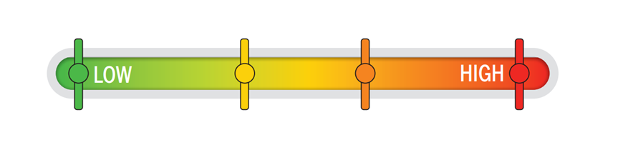
Does this information change your level of concern?
Intermittent episodes of legs feeling weak when running
Intermittent H/O numbness in both legs in a non dermatomal distribution, possibly more obvious when in supine lying?
Of Somalian origin

Slide 6
Vitamin D deficiency Aug 2022 – 12 nmol/L. Supplementation prescribed at the time but no on-going supplementation
Non smoker, fit and well otherwise
Asylum seeker from Somalia – UK entry 2021
13/12/21 TB QuantiFERON test screening – Negative
Are there any other differentials that you would consider based on this information?

Slide 7
Objective Examination
Normal gait, walks unaided
No Ataxia , no limb atrophy
Prominent spinous process / mass T8/9 level – non tender (H/O direct trauma to this area many years ago with no on-going symptoms at this level). Tender L1-L3 paraspinals
Lumbar ROM limited to 50% due to LBP
Lower limb neurology intact with no deficits
Normal tone
Brisk DTR B/L knee and ankle

Slide 8
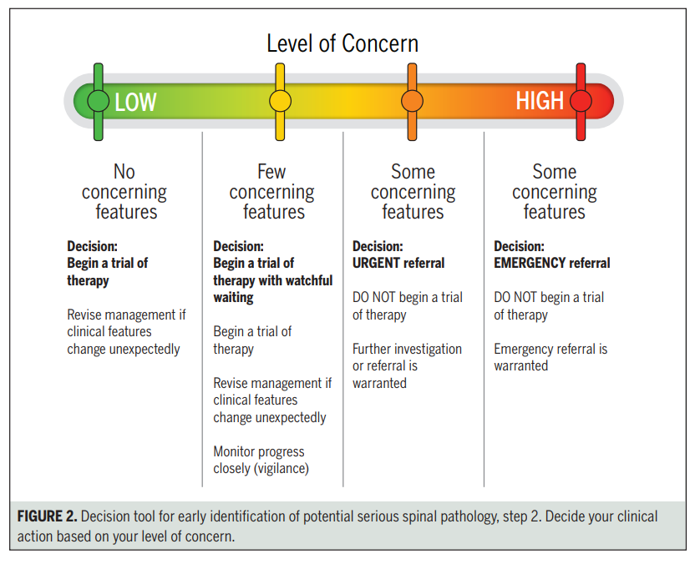

Slide 9
What would be your management plan for this patient if seen in your clinic ?

Slide 10
Clinical Impression - ? Mechanical LBP
Cause for lower limb symptoms ?
Referred pain from Lx spine?
? Serious spinal pathology
Plan
MRI thoracic and lumbosacral spine
SDM / Safety netting advise

Slide 11
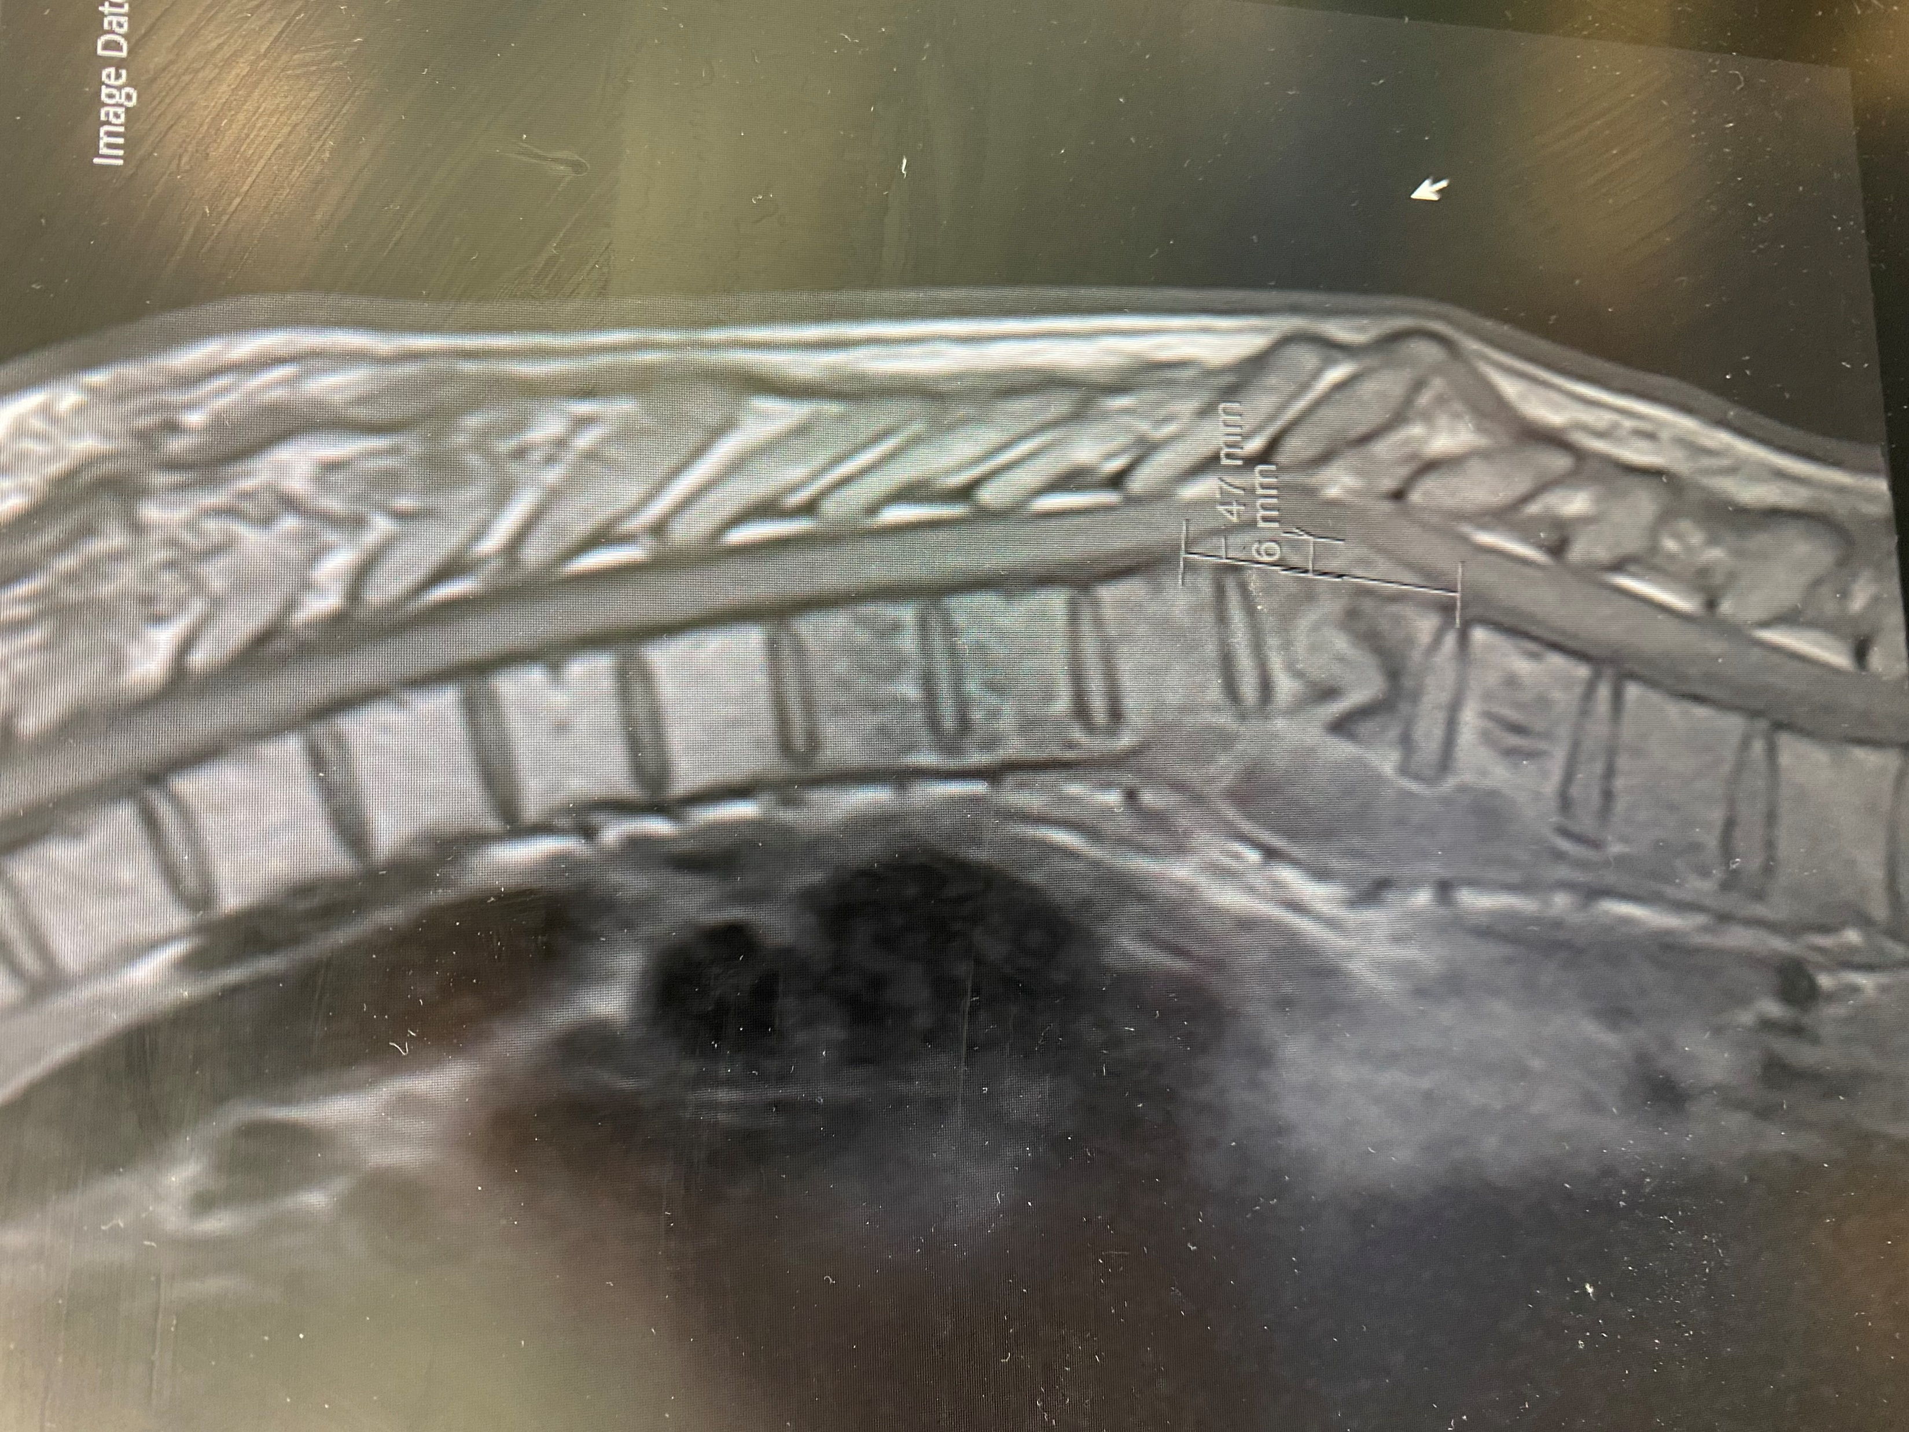
Florid tuberculous spondylodiscitis at T9/10 with very extensive paravertebral collections

Slide 12
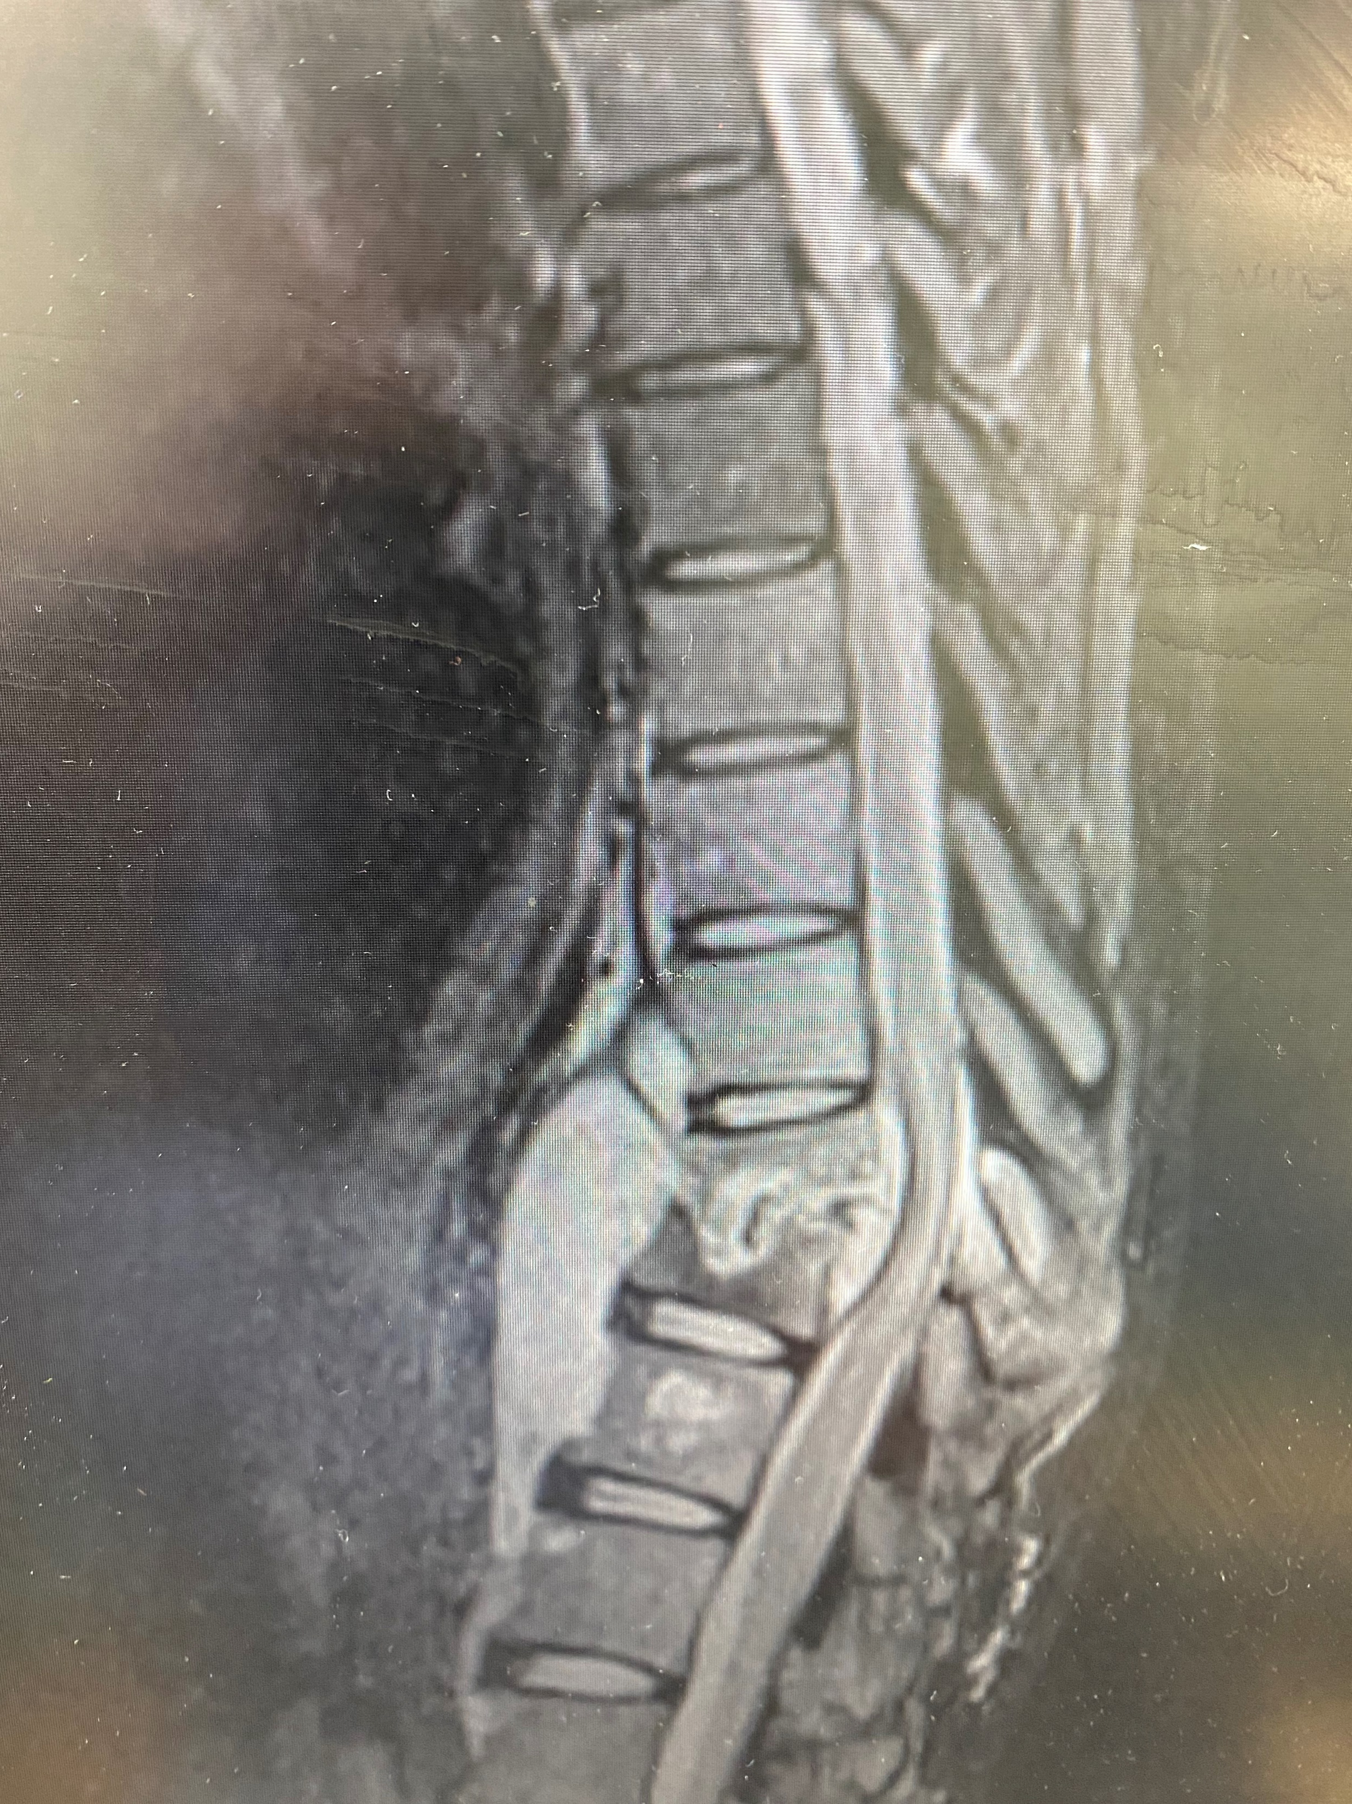

Slide 13
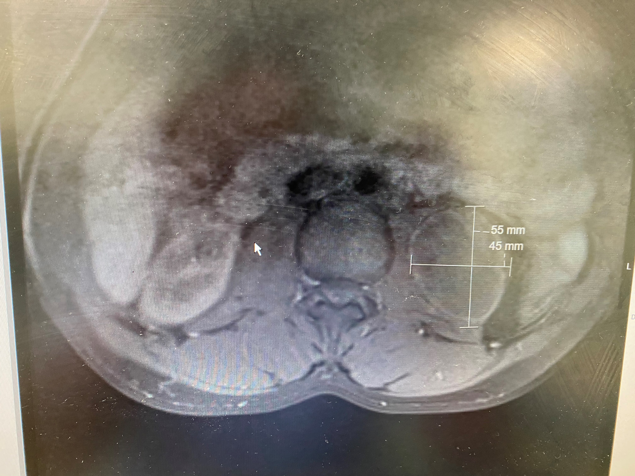

Slide 14
Reflection / Clinical Reasoning
Presentation was suggestive of Mechanical type of LBP and there were some aspects in this history that did point towards a diagnosis of MLBP. However, lower limb symptoms in a non-dermatomal distribution when resting does not fit in with a mechanical LBP diagnosis. This combined with objective examination findings and “gut feeling” prompted clinician to arrange further diagnostics in the form of an MRI scan of the thoracic and lumbosacral spine. Spinal infection was not a top differential in this case and this is worth exploring further. A negative QuantiFERON test, normal neurology and the absence of systemic symptoms perhaps was falsely reassuring? This case highlights the importance of a patient’s RISK PROFILE despite the reassuring neurological status and absence of obvious red flags.

Slide 15
@ Risk population groups for spinal infection
Diabetes / Immunosuppressed population
HIV
long-term steroid use
Smoking
Social and environmental factors like intravenous drug use, obesity, birth in a TB-endemic country, family history of TB, and living conditions (overcrowded living, homelessness, imprisonment)
Spinal surgery

Slide 16
The classic triad of clinical features comprises back pain, fever, and neurological deficit. However, many people do not present with all 3 features.
What % of people report fever as a symptom ?
Absence of fever cannot rule out spinal infection.

Slide 17
Interferon-Gamma Release Assays (IGRAs) – Blood Tests for TB Infection
Blood samples must be processed within 8-30 hours after collection while white blood cells are still viable.
Errors in collecting or transporting blood specimens or in running and interpreting the assay can decrease the accuracy of IGRAs.
Limited data on the use of IGRAs to predict who will progress to TB disease in the future.

Slide 18
Key points to remember
Spinal infection is a relatively rare condition with studies suggesting an incidence of 0.2 -2.4 cases per 100,000 in western societies. The insidious onset of spinal infection can create a complex clinical picture, as patients can remain relatively healthy until symptoms manifest themselves in the later stages of the disease
Spinal infection is often typically thought as having a long prodromal period therefore unsurprisingly, errors in the diagnosis of spinal infection is relatively frequent
Significant economic costs associated with spinal infection / subsequent litigations

Slide 19
Key themes resulting in missed / late diagnosis of spinal infection – International Framework for spinal red flags.
1) A failure to recognise the red flags
2) Failing to consider spinal infection as a differential diagnosis.
Understanding the signs and symptoms of spinal infection and the risks of spinal infection an individual may have, can help raise the index of suspicion and aid in the early identification of Spinal Infection

Slide 20


Slide 21
10 centres spread across Nigeria (10 year period)
124,913 case notes reviewed
1645 patients with confirmed spinal infection
Prevalence of 1.32% (0.01% in Denmark MSK Physiotherapy setting)

Slide 22
Outcome
21 Jan - A and E review arranged post MRI results review for admissions assessment
CRP 1.1, Lymphocytes 0.8 (1.0-3.8), Normal bone profile and LFT
XR Chest :Marked widening of the paravertebral stripes
in keeping with paraspinal tuberculosis. The lungs are
otherwise clear. Normal heart size
30/1/23 – Spinal surgery

Slide 23
Useful Resources
Finucane, L.M., Downie, A., Mercer, C., Greenhalgh, S.M., Boissonnault, W.G., Pool-Goudzwaard, A.L., Beneciuk, J.M., Leech, R.L. and Selfe, J., 2020. International framework for red flags for potential serious spinal pathologies. journal of orthopaedic & sports physical therapy, 50(7), pp.350-372
Loh, F.K., Thong, P.M. and Ong, C.W. (2022) “The crucial need for tuberculosis translational research in the time of COVID-19,” The Lancet Respiratory Medicine, 10(6), pp. 531–533. Available at: https://doi.org/10.1016/s2213-2600(22)00099-6.
https://resolution.nhs.uk/resources/nhs-resolution-podcast-spinal-infections/
Yusuf, M., Finucane, L. and Selfe, J. (2019) “Red Flags for the early detection of spinal infection in back pain patients? A systematic scoping review,” Physiotherapy, 105. Available at: https://doi.org/10.1016/j.physio.2018.11.164.

Slide 24
Thanks for listening!
Any Questions?

